Slide 1




MAJOR PROJECT REPORT
MUSIC PLAYER IN PYTHON

Slide 2
INTRODUCTION:
It is device in which we can play our favourite songs of different length .We can pause the song, resume it, stop it and we can listen next song or also we can listen previous song.
We use mp3 format to save our song in phones , laptops, tablets , Iphones and in many more devices.

Slide 3
MP3 Player:
MP3 is a standard technology, and compressed audio file format stands for "MPEG Audio Layer-3," which is developed by MPEG (Moving Picture Experts Group). A file extension and compression method for compressing a sound sequence into a very small file while still retaining audio quality as comparad to a CD. Commonly, MP3 files need less disk space and are used to hold a song or the whole CD data. A computer can save many numbers of songs, even several hundred or thousands, as MP3 files require very small storage space. There is a number of websites that allow users to download MP3 files, which are identified with the file name suffix of ".mp3."
Contd.

Slide 4
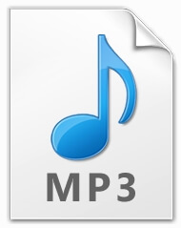
MP3 Player:
The MP3 File Format:
A header compressed audio and metadata are included in an MP3 file. The information about the audio is contained by the header. Better sound quality is produced by a high bitrate and sample rate, but it makes the file size larger. The information about the actual recording is provided by the MP3 metadata.

Slide 5
OBJECTIVE:
In our daily life, we see every person has a hobby and that is listening to music. So in order to listen to music, they all need a Music player(hardware or software) where they can play their favorite songs. And we have to install this music player on our computer, based on the Operating system i.e Windows, Macintosh, Android, Linux, etc. Then we can listen to our favorite songs.
Wouldn’t it be cool to have our very own mp3 music player. So, in this python project, we are going to create an mp3 player with the help of python and its libraries.

Slide 6
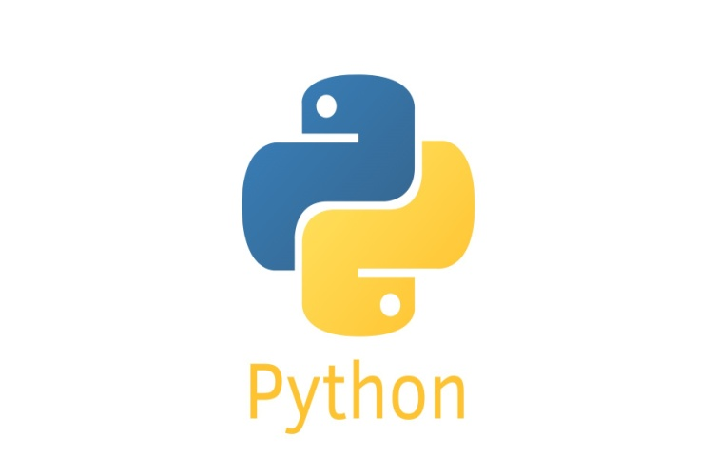
LANGUAGE USED:
PYTHON
It is a General Purpose object-oriented programming language, which means that it can model real-world entities. It is also dynamically-typed because it carries out type-checking at runtime.

Slide 7
Requirement Analysis:
Tkinter
It is a standard GUI Python library that is one of the fastest and easiest ways to build GUI applications using Tkinter.
Running python -m tkinter from the command line should open a window demonstrating a simple Tk interface, letting you know that tkinter is properly installed on your system, and also showing what version of Tk is installed, so you can read the Tk documentation specific to that version.

Slide 8
Requirement Analysis:
2. PYGAME:
Pygame is a set of Python modules designed for writing video games. Pygame adds functionality on top of the excellent SDL library. This allows you to create fully featured games and multimedia programs in the python language.
Pygame is highly portable and runs on nearly every platform and operating system.
Pygame itself has been downloaded millions of times.
Pygame is free.

Slide 9
TOOL USED FOR CODING:
Visual Studio CODE:
Visual Studio Code is a source-code editor made by Microsoft for Windows, Linux and macOS.
Features include support for debugging, syntax highlighting, intelligent code completion, snippets, code refactoring, and embedded Git.
Users can change the theme, keyboard shortcuts, preferences, and install extensions that add additional functionality.
Visual Studio Code was first announced on April 29, 2015, by Microsoft at the 2015 Build conference. A preview build was released shortly thereafter

Slide 10
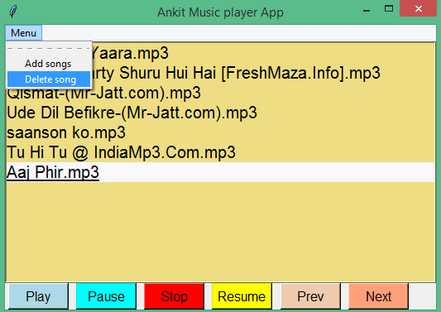
OUTPUT:
Menu for adding and deleting Songs
Songs List
Buttons for playing , pause , stop, resume the song…

Slide 11



